Slide 1






Climate change and its effect on crop yield in developing countries
A Case study of Nigeria, ghana, Kenya and south Africa.
Group 7

Slide 2
TEAM MEMBERS
Group 7
Maryam Adesokan
Kenechukwu Jane
Ibukunoluwa Ogunnaike
Olajumoke Bakare
Mary Akinsande
Oreoluwa Daramola
Oluchukwu Okorie
Hamdiya Adams
Lilian Ugwu

Slide 3
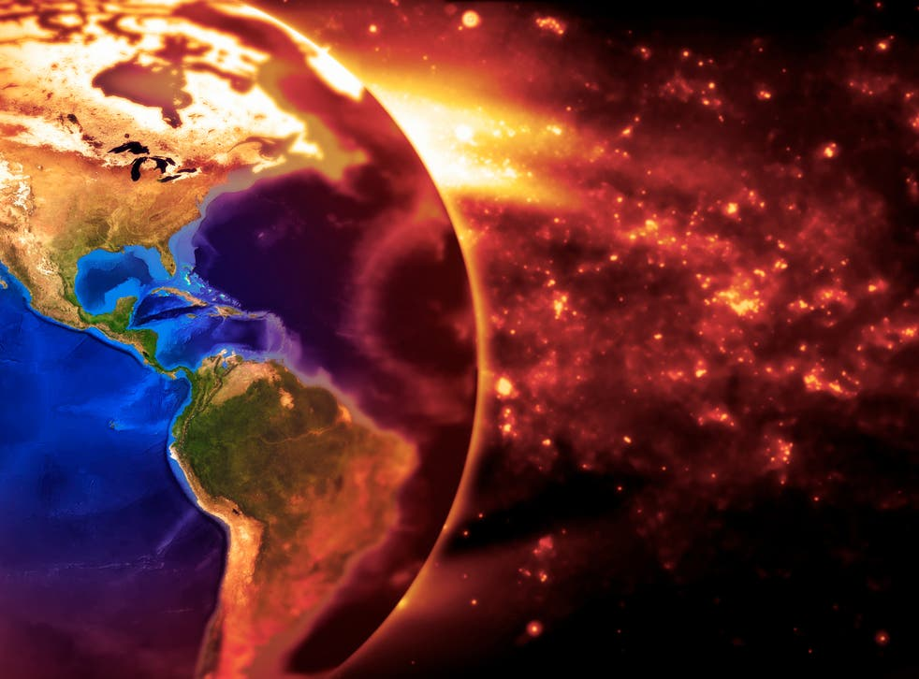
INtroduction
Global warming has become one of the most prevalent environmental issues critically discussed. Due to the adverse impacts, global warming has on crop yields, active weather patterns, sea levels and ecological systems. Since 1850, when the record of global temperature began to be kept, temperature has always been on the increase and is expected to rise by 1.8ºC to 8.5ºC by the end of this century.

Slide 4

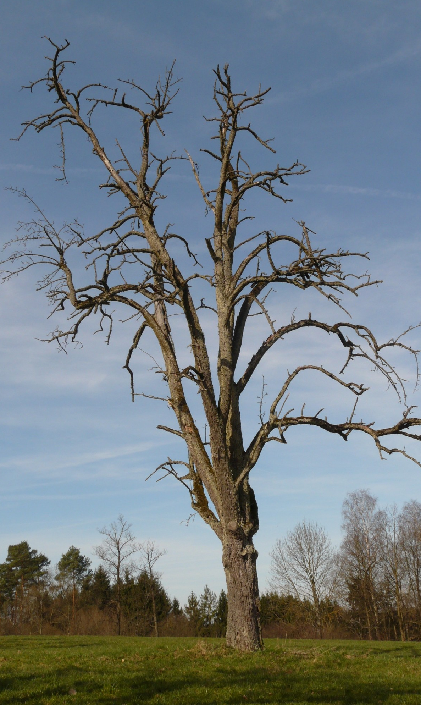
Global warming is caused by the emission of greenhouse gases like carbon dioxide, methane, chlorofluorocarbons and nitrous oxide. These gases cause an insulating effect on the climate which causes the atmosphere to trap heat and warm the earth. The actives of these gases on the climate affect the soil which in turns affect crop yield. With the world population expected to hit double by 2050, global food production would have to double to meet the need of the rising population. The threat to food security from climate change is a critical issue for sustainable agriculture and a sufficient number of businesses. Developing countries may be more at risk of food scarcity.
4

Slide 5
Goal and objectives of the study
The goal of this study is to perform an exploratory analysis on how the variables of climate change; temperature and rainfall pattern affect crop yields in four countries in Africa. The case study is Ghana, Kenya, Nigeria, and South Africa.
Goal
5

Slide 6
Objectives
To determine the extent variations in temperature, affect crop yield in different countries.
To determine the extent variations in rainfall patterns, affect crop yield in different countries.
6

Slide 7

Hypothesis:
Does climate change have an effect on crop production in developing countries?
Research questions:
Is there a correlation between an increase in temperature and crop yield?
Does the amount of rain fall affect crop yield in developing regions?
7

Slide 8
To ensure a correlative conclusion, we used common crops found in the countries selected. The crops include the following:
Rice
Maize
Cotton
Sugarcane
Millet
Data was mined, collected, cleaned and visualized from the year 2010 to 2018.
8

Slide 9
Annual crop YIELD GAP
Crop yield gap is the difference between yield potential and average farmers yield over a specified area or period of time i.e. the higher the yield gap the lower the production. Factors that affect crop yield gap include flood, drought caused by climatic changes.
After the database was retrieved and sorted. Analysis and visualization was carried out on the annual production of the selected crops rice, maize, cotton, sugarcane and millet among the 4 countries within the year of 2010 – 2018.
9

Slide 10
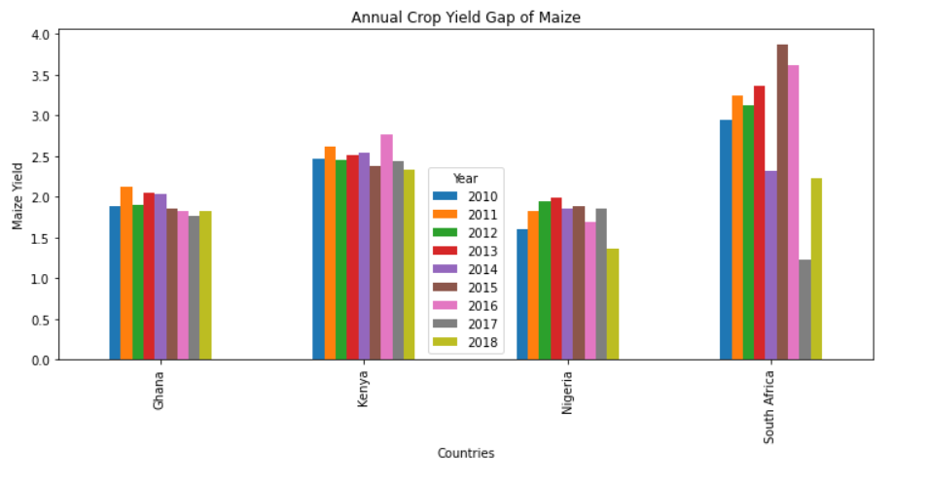
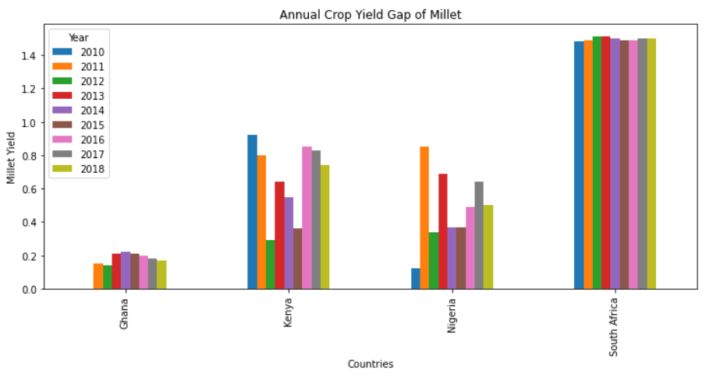
The graphs indicates that Ghana and Nigeria have the lowest yield gap between the year 2010 to 2018 producing maize and millet and hence are the largest maize and millet producers

Slide 11
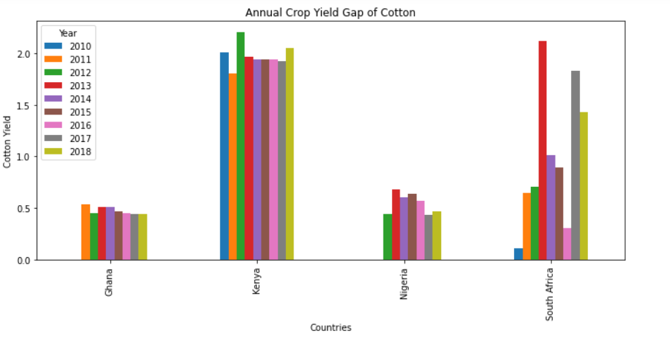
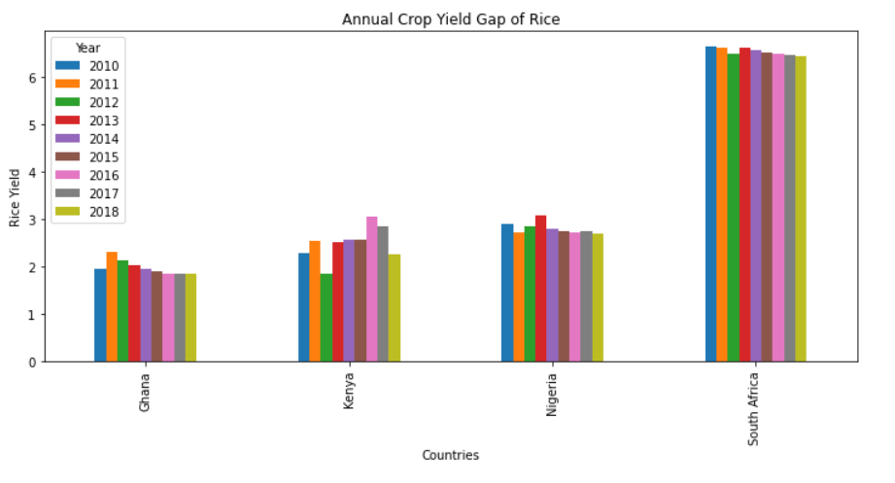
The graphs indicates that Ghana and Nigeria have the lowest yield gap between 2010 to 2018 producing cotton, while Ghana, Kenya and Nigeria maintain a close yield gap for rice, and also, close level of production.

Slide 12
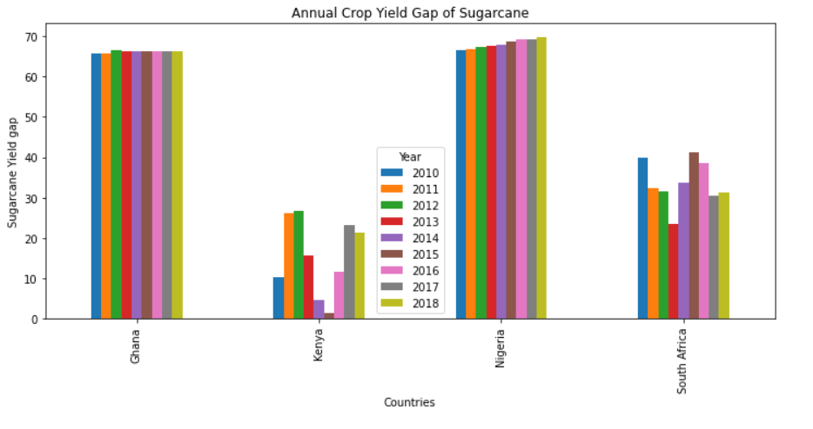
Unlike the previous analyzed field gaps where Ghana has a lesser yield gap. The level of produced Sugarcane in Kenya is twice as much produced in South Africa.
12

Slide 13
Through the visual analysis of the crop yield gap over the stipulated period, it has been shown that Nigeria and Ghana are the largest producing crop countries between the year 2010 to 2018, producing thrice as much as the least producing country. Kenya is the next producing country. However, production is gradually declining over the years and sparing remained constant.
Sugarcane however proved to have last the test of time by gradually increasing in production in South Africa.
We need to consider the average temperatures in these countries and how it affects the production of crops.
13

Slide 14
ANNUAL Average temperature
After the visual representation of the crop yield that reflects the level of production, it is however important to note the level of temperature over the years to determine how temperature influence the production of crops in the 4 countries.

Slide 15
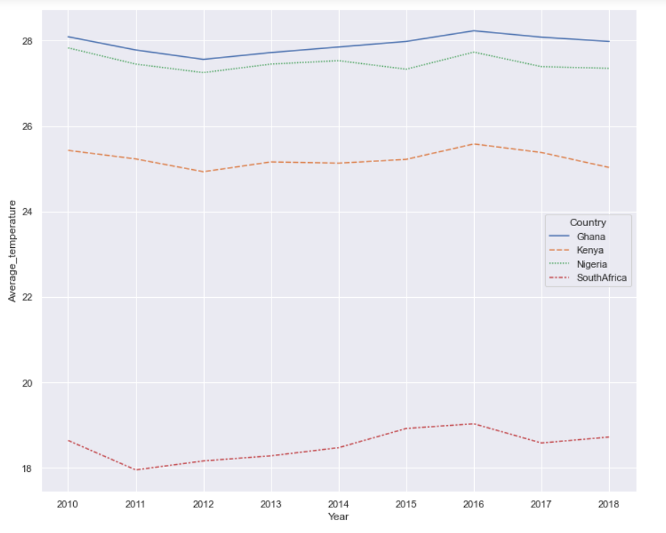
15

Slide 16
Average temperature
Graphically, Ghana has shown to be the hottest country, followed by Nigeria at 27ºC – 28ºC minimum Temperature between the year 2010 and 2018.
Kenya is the next hot state at 25ºC minimum temperature.
However, South Africa, the least crop producing country is seen to be the coolest country as it’s temperature is within 18ºC – 19ºC minimum temperature.
The analysis visualized the effect of temperature on crop production; based on the findings, most crops have been seen to thrive and succeed better in Africa’s hot climates.
16

Slide 17
Annual AVERAGE temperature Vs crop yield
For further aid of the objective, it is important to visualize the relationship between the annual average temperate and each individual crop yield.
17

Slide 18
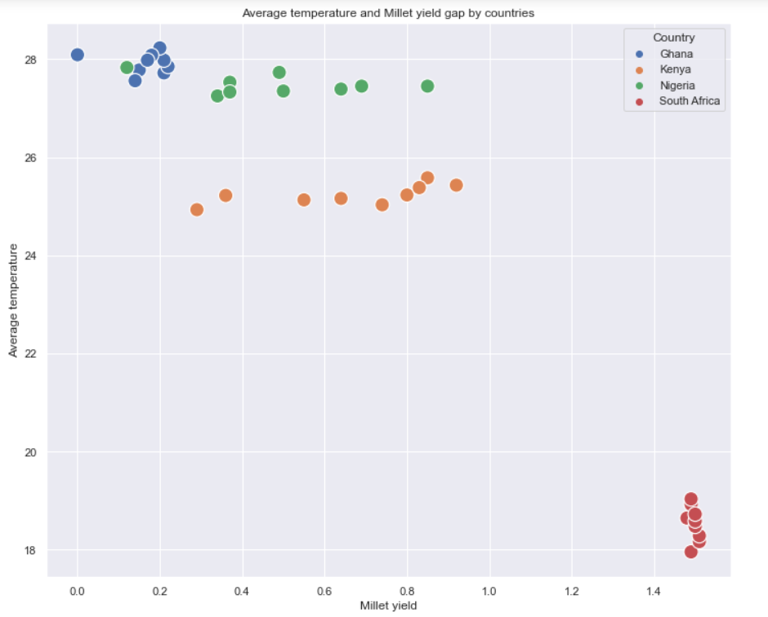
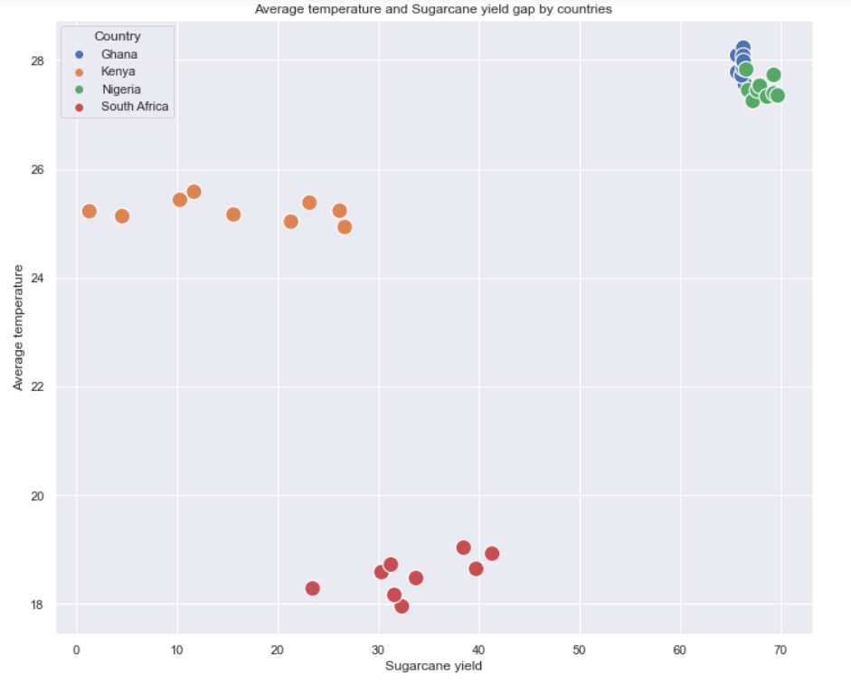
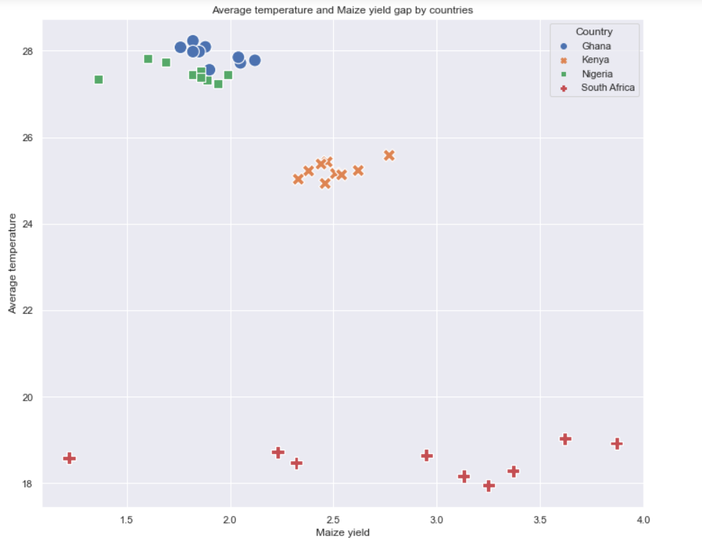
The graph shows that the higher the temperature of the climate, the higher the crop production and…
18

Slide 19
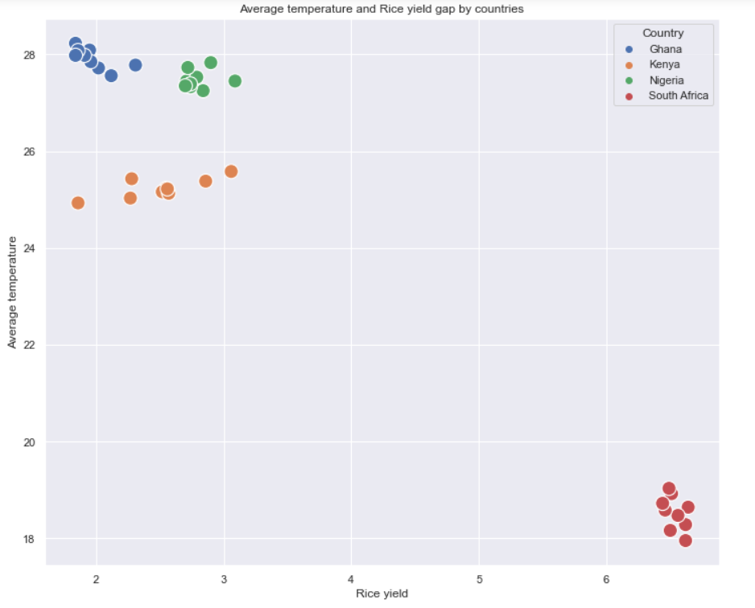
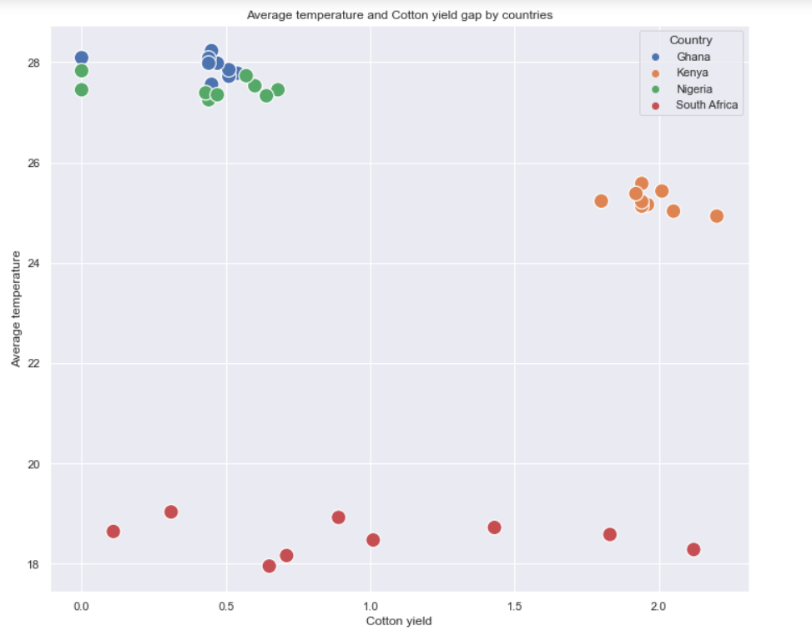
…the lower the temperature of the climate the lesser the crop production as seen in the case of Ghana and South Africa.
19

Slide 20
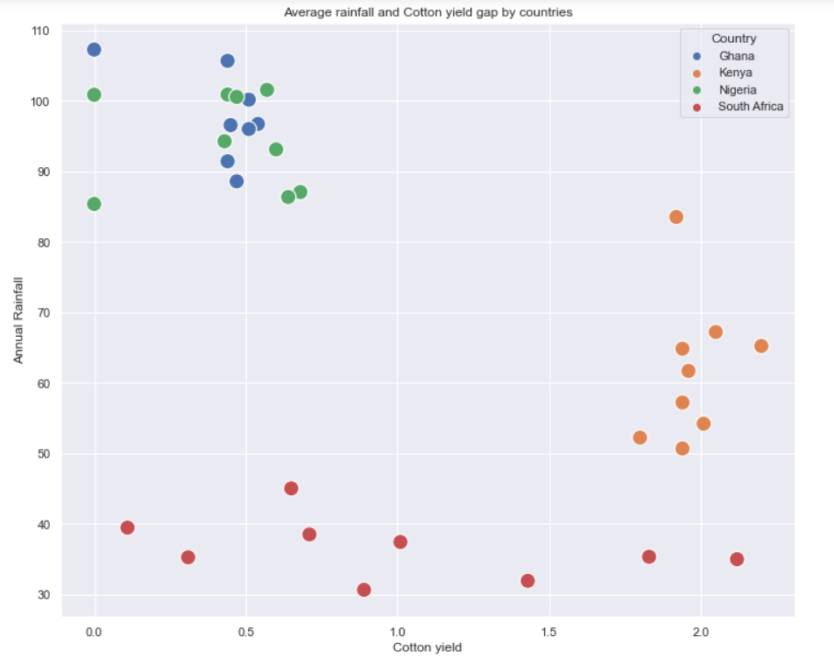
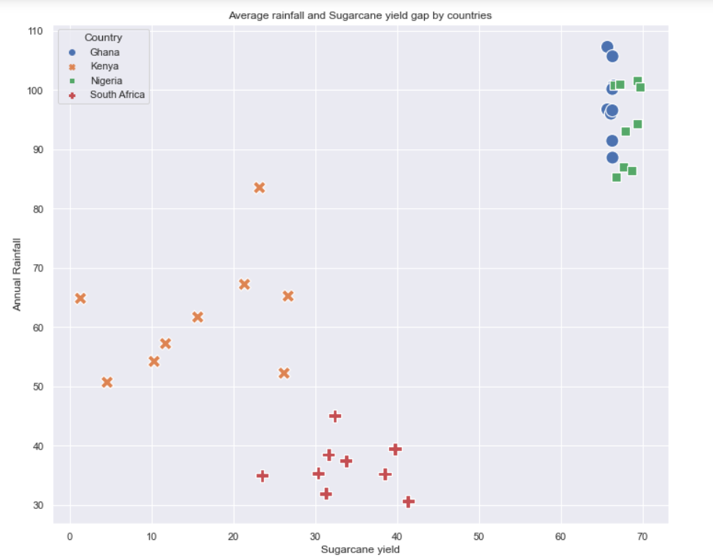
Annual Rainfall Vs and crop yield
Graphically visualizing the relationship between rainfall and crop yield to determine the effect of rain on crop production

Slide 21
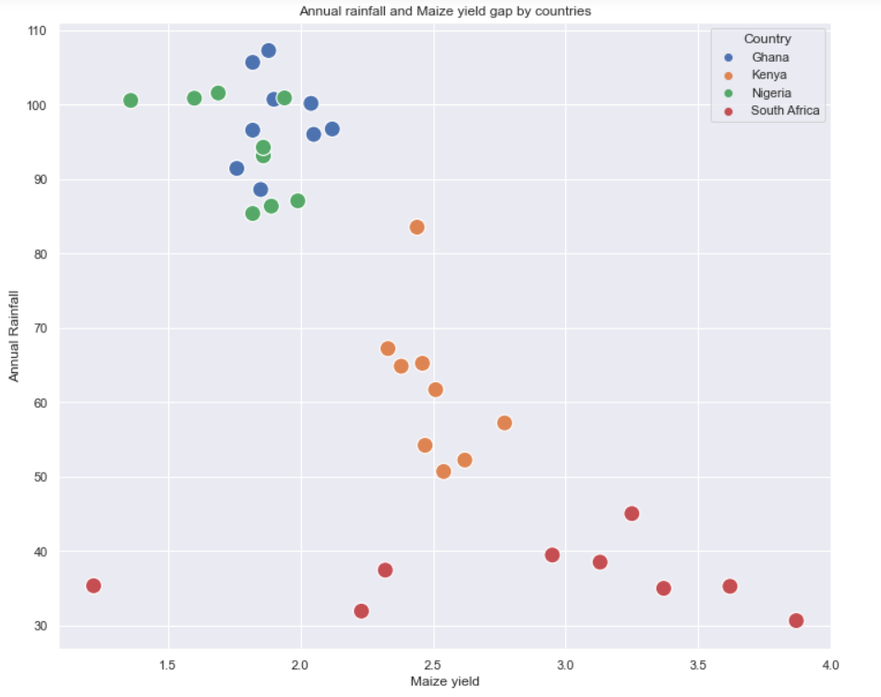
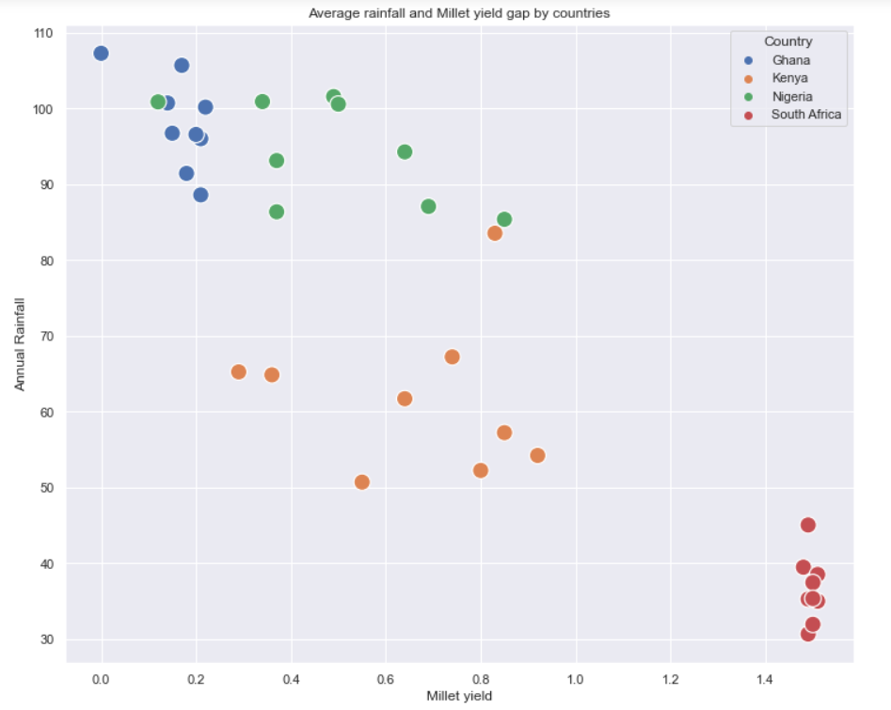
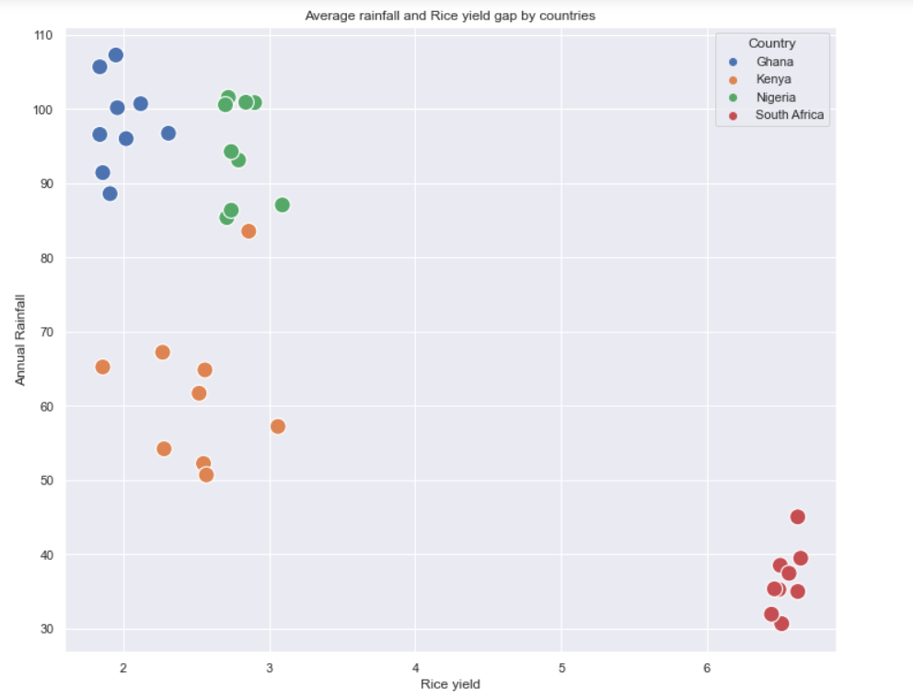
21

Slide 22
OBSERVATIONS
With visual analysis of crop production between the year 2010 to 2018 and climate change (rainfall and temperature), it has been observed that climate indeed influence yield gap and is statistically significant to the crop production. Also, it is shown that there is an optimal temperature at which certain crops grow well, and it is observed here that at 27ºc temperature, at this temperature, countries have a lower yield gap and as such produces more crop production for consumption. However, global warming increases daily and with time it is possible this optimal conditions for crop growth may not be achieved.
22

Slide 23
CONCLUSIONS
Based on our findings, to a very large extent, climate change affects crop production and the yield gap annually. However, some crops like sugarcane are still favoured by climate change.

Slide 24
RECOMMENDATIONS
The following are the recommendations to aid better crop production:
Use of alternative sources of fuel that are environmentally friendly. E.G. Biogas and geothermal energy.
Reduced carbon concentration in the atmosphere by gradually banning the use of carbon emitting automobiles
Reduce depends on rain fed agriculture and practice irrigation farming.
Due to the time frame of the project we were able to cover 8 years, for a more in depth view on climate change we recommend more years and countries to be covered.

Slide 25
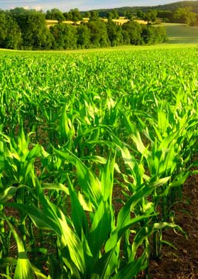
THANK YOU!

